Slide 1
Sell-Through Merchandise Security
Product Line Details
8/27/20

Slide 2
Index
Keys
Package Protection
Secure Fixtures
Keys
IR (OneKEY) Key
OM Key
Q4 (S3 equivalent) Key
Detachers
OneKEY Detacher
Locking Hooks
IR (OneKEY) Locking Hooks
OM (SH500) Locking Hooks
Q4 (S3 equivalent) Locking Hooks
Accessories
Safers
Safers
Package Wraps
Package Wraps
StopLoks
IR (OneKEY) StopLoks
OM (SL500) StopLoks
Q4 (S3 equivalent) StopLoks
Cable Locks
Cable Locks
Flexible Locking Hooks
IR (OneKEY) Flexible Locking Hooks
OM (SH500) Flexible Locking Hooks
Accessories
Bottle Caps
Bottle Caps
Dispensers
T1000 Dispenser
Helix Dispenser
Anti-Sweep Hooks
Q4 (S3 equivalent) Anti-Sweep Hooks

Slide 3
Go to Index
Keys
Give every associate a key to increase sales, decrease theft and improve safety.

Slide 4
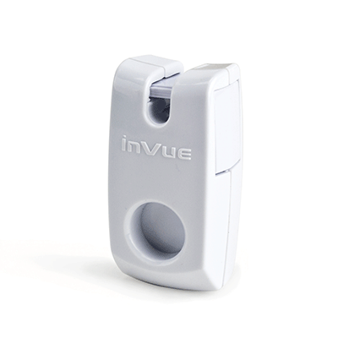
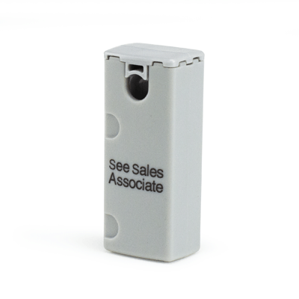
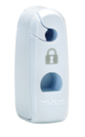
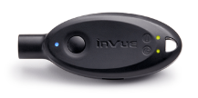
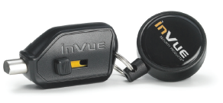
Go to Index
Keys
Keys
Unlocks Secure Fixtures magnetically or electronically.
When finding an Order Code, you need to consider:
Key type: magnetic or OneKEY?
If magnetic, what interface profile: D-shape or tab(s)?
Interface Profile
Circle
D-Shape
Tab(s)
IR (OneKEY) Keys
OM (SFKEY) Keys
Q4 (S3) Keys

Slide 5
Go to Index
Keys
IR Keys
Unlocks IR Locking Hooks, IR StopLoks, and IR Flexible Locking Hooks
Greyed out Order Codes are Non-Stock
IR Version | Key
IR | AF4400^{1,9} AF4400-T² AF4400K3^{2,5}
IR2 | PK4400 PK4491^{3,8}
IR3 | AF4450⁴ AK4400 AK4500⁶ AK4500-S^{6,7}
NOTES:
Grey button
No time out feature
No split ring
Kit (2 keys)
Fixed code
Includes contacts
Sounder
Recoiler
Includes fob

Slide 6
Go to Index
Keys
OM Keys
Unlocks OM Locking Hooks, OM StopLoks, and OM Flexible Locking Hooks
Used to install and remove Helix Dispenser
Greyed out Order Codes are Non-Stock
EAS Coil | Key
AM | SFKEYND^{3,4} SFKEY3ND¹ SFKEYNDRL³ SFKEY3NDRL^{1,3}
RF | SFKEYRF^{3,4} SFKEY3RF¹ SFKEYRFRL³ SFKEY3RFRL^{1,3}
Greyed out Order Codes are Non-Stock
Add-on Component | Order Code
Belt Recoiler | Q4IREEL3
NOTES:
OM/Q4 combo
Alternative pack quantities
Recoiler
Includes fob

Slide 7
Go to Index
Keys
Q4 Keys
Unlocks Q4 Locking Hooks, Q4 StopLoks, and Q4 Flexible Locking Hooks
Greyed out Order Codes are Non-Stock
EAS Coil | Key
AM | Q4KEYNDRL¹ Q4KEYND
RF | Q4KEYRFRL¹ Q4KEYRF Q4IHKCVRFL²
NOTES:
Recoiler
Customer specific label

Slide 8
Go to Index
Package Protection
Provides superior protection for high-value merchandise. Designed for ease of use and a wide range of applications.

Slide 9
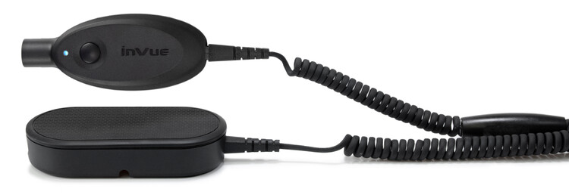
Go to Index
Detachers
Detachers
Unlocks and disarms security device for removal.
OneKEY Detacher

Slide 10
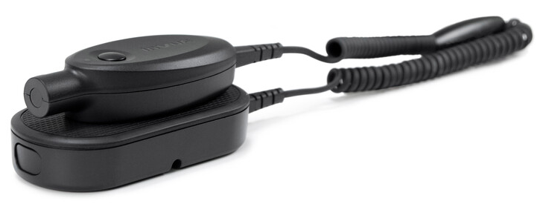
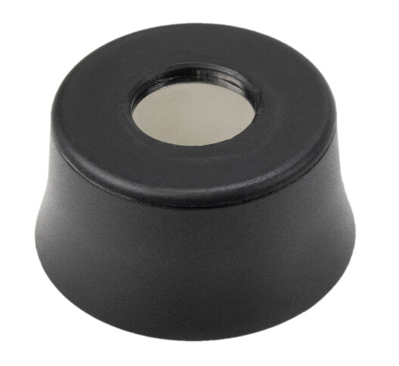
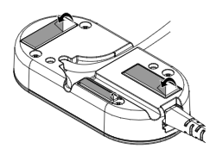
Go to Index
Detachers
OneKEY Detacher
Removes Safers, Package Wraps, Cable Locks, and Bottle Caps
Has integrated S3 magnets to detach S3 keepers
OneKEY Detacher
Greyed out Order Codes are Non-Stock
Item | Order Code
Detacher | AKD40¹
Magnetic Counter Detacher
Greyed out Order Codes are Non-Stock
Add-on Component | Order Code
Cable | AKD41
Magnetic Counter Detacher | AKD49
Replacement Adhesive | ADH2320²
Replacement Adhesive
NOTES:
Requires PS18V
5 pack

Slide 11
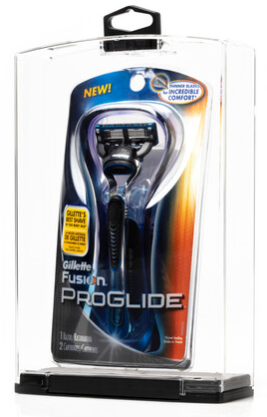
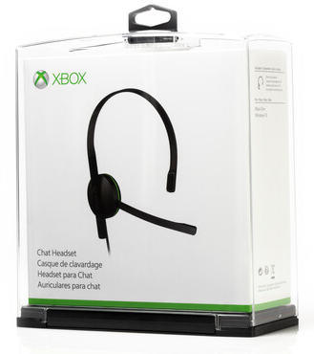
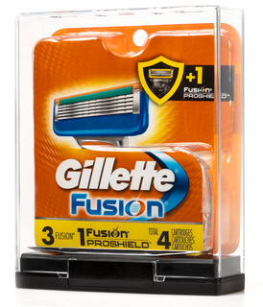
Go to Index
Safers
Safers
Fully enclosed housing with locking lid.
When finding an Order Code, you need to consider:
Dimensions: height, width, depth?
Which EAS coil: AM or RF?
How is it merchandised: hanging or shelved?
Safers

Slide 12
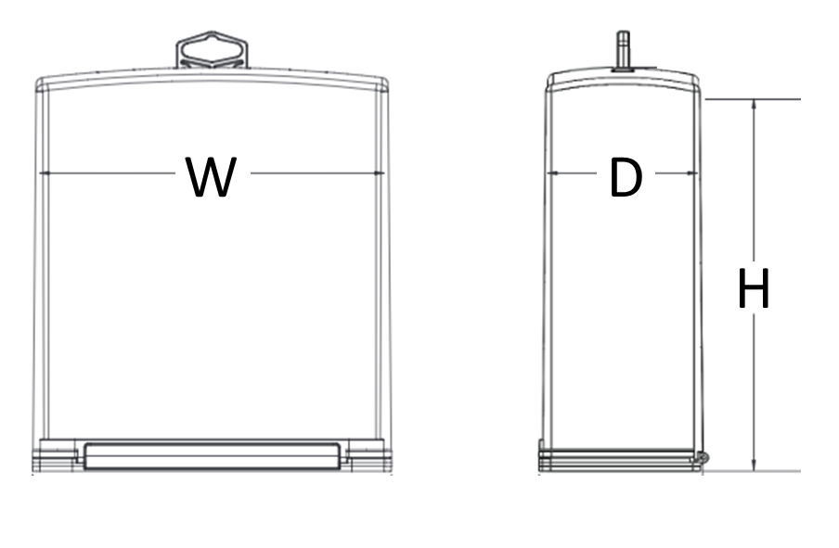
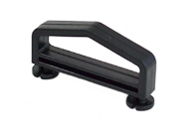
Go to Index
Swivel Tag
Safers
Safers
Uses the OneKEY (IR2 and beyond) to unlock
Greyed out Order Codes are Non-Stock
Lid
Width (W)
Height (H) | 4.1” | 4.95” | 5.5” | 5.8” | 6” | 7” | 7.25” | Depth (D)
4.6” | NB6AM² NB6RF³ |  |  |  |  |  |  | 1.0”
4.95” |  | NB11 |  |  |  |  |  | 2.66”
5.5” |  |  |  | NB5 NB5-S¹ |  |  |  | 1.8”
7.25” |  |  |  |  |  | NB3 NB3-S¹ |  | 2.75”
8” |  |  | NB2 NB2-S¹ |  |  |  |  | 1.375”
8” |  |  | NB1 NB1-S¹ |  |  |  |  | 1.75”
8.5” |  |  |  |  | NB10 |  |  | 0.9”
10.25” |  |  |  |  |  |  | NB4 NB4-S¹ | 2.5”
Greyed out Order Codes are Non-Stock
Hang Tag
Add-on Component | Order Code
Hang Tag | NBTAG^{4,5}
NOTES:
Swivel tag
Includes AM EAS coil
Includes RF EAS coil
20 pack
Only works with NB6 & NB11

Slide 13
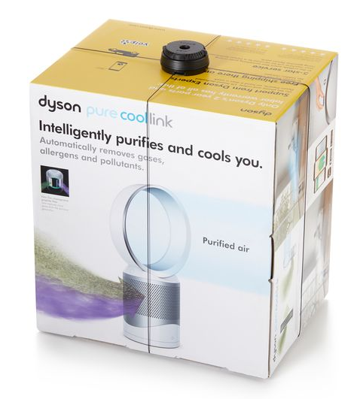
Go to Index
Package Wraps
Package Wraps
Cable wrap with a top unit push button and ratcheting mechanism.
When finding an Order Code, you need to consider:
Cable length: 52”, 70”, 102”?
Package Wraps

Slide 14
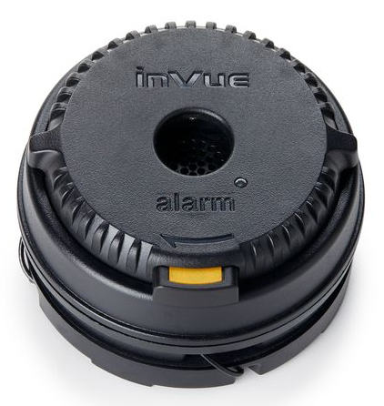
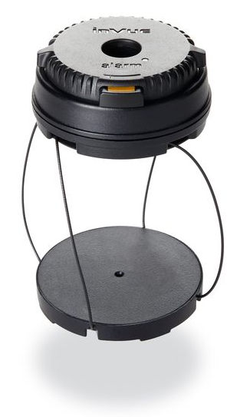
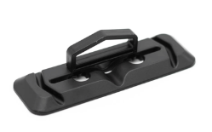
Go to Index
Package Wraps
Package Wraps
Uses the OneKEY (IR2 and beyond) to release
Greyed out Order Codes are Non-Stock
Cable Length
Body Style | 52” / 132cm (Small) | 70” / 178cm | 102” / 259cm (Large)
Ratcheting | NW52¹ |  | NW100¹
Non-Ratcheting |  | NW70¹ | NW102¹
Hang Tab
Greyed out Order Codes are Non-Stock
Add-on Component | Hang Tab
Hang Tab | NW-HANGTAB²
NOTES:
Includes both AM and RF coils
20 pack

Slide 15
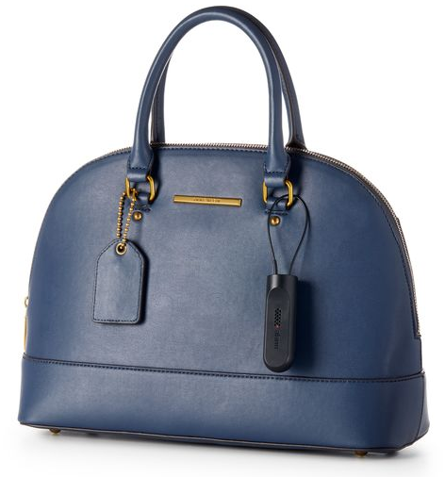
Go to Index
Cable Locks
Cable Locks
Cable loop locking mechanism.
When finding an Order Code, you need to consider:
Alarm type: 2-alarm or 3-alarm?
Cable length: 3”, 6”, 48”, 70”?
Which EAS coil: AM or RF?
Cable Locks

Slide 16
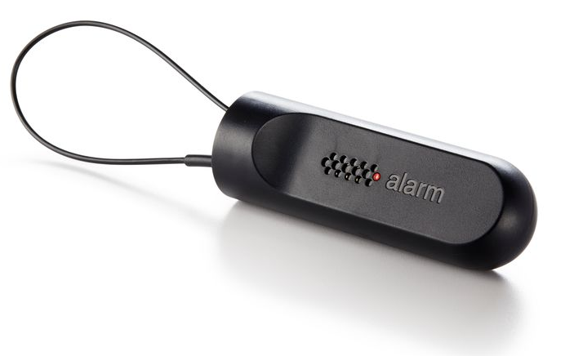
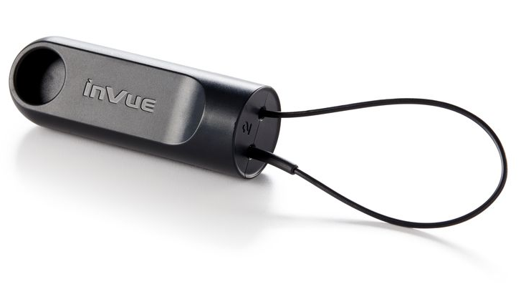
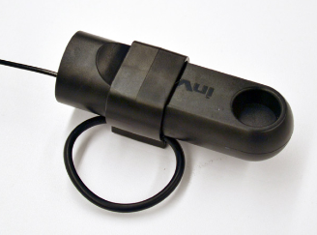
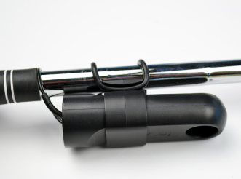
Go to Index
Cable Locks
Cable Locks
Uses the OneKEY (IR2 and beyond) to unlock
2-Alarm
Greyed out Order Codes are Non-Stock
Cable Length
EAS Coil | 6” / 15cm | 48” / 122cm | 70” / 178cm
AM | NCSAM2 | NCLAM2 | NC70AM2
RF | NCSRF2 | NCLRF2 | NC70RF2
3-Alarm
Greyed out Order Codes are Non-Stock
Cable Length
EAS Coil | 3” / 8cm | 6” / 15cm | 48” / 122cm
AM |  | NCSAM3-50¹ NCSAM3-60² | NCLAM3-50¹ NCLAM3-60²
RF | NC3RF3-C³ | NCSRF3-C³ | NCLRF3
Cable Lock Clip for Golf Club
Greyed out Order Codes are Non-Stock
Add-on Component | Order Code
Cable Lock Clip for Golf Club Shaft | NC-CLIP
NOTES:
50 Hz Power
60 Hz Power
Custom firmware

Slide 17
Go to Index
Bottle Caps
Bottle Caps
Front end push button or turn knob with locking back.
When finding an Order Code, you need to consider:
Bottle Top Diameter: 24-31mm, 31-36mm, 36-41mm?
Which EAS coil: AM or RF?
Bottle Caps

Slide 18
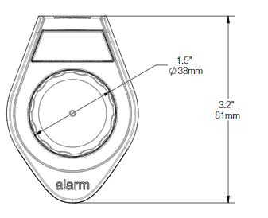
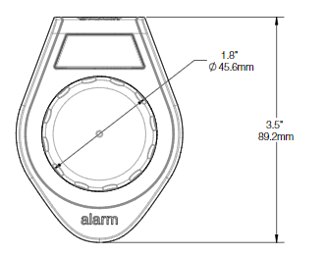
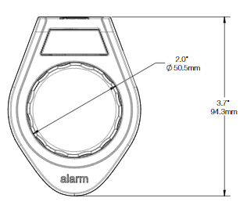
Go to Index
Bottle Caps
Small Bottle Cap
Bottle Caps
Uses the OneKEY (IR2 and beyond) to unlock
Greyed out Order Codes are Non-Stock
Bottle Top Diameter
Medium Bottle Cap
EAS Coil | 24 – 31mm (Small) | 31 – 36mm (Medium) | 36 – 41mm (Large)
AM | NBCS-AM | NBCM-AM | NBCL-AM
RF | NBCS-RF | NBCM-RF | NBCL-RF
Large Bottle Cap

Slide 19
Go to Index
Secure Fixtures
From innovative dispensers to flexible locking hooks – our secure fixtures are designed to be easy to use and tough to defeat.

Slide 20
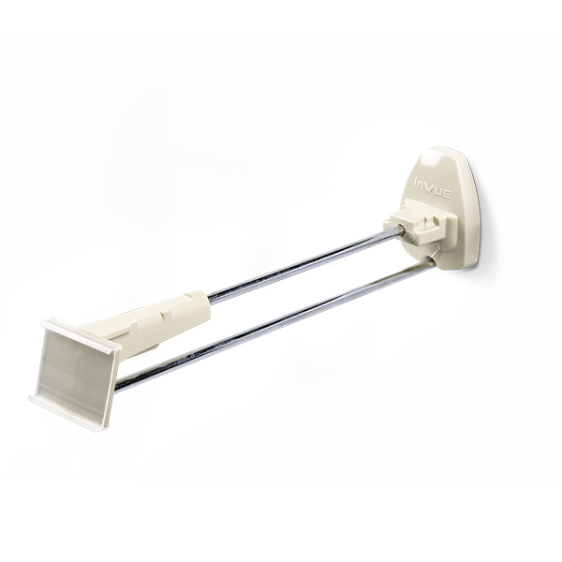
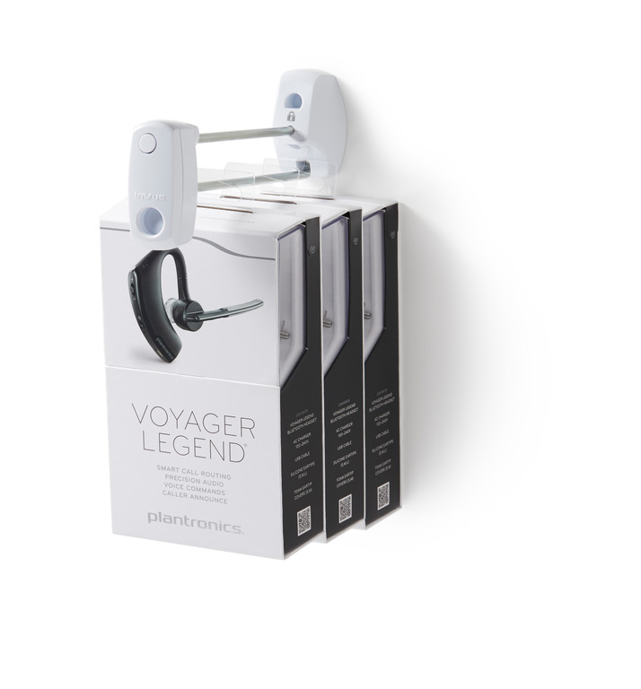
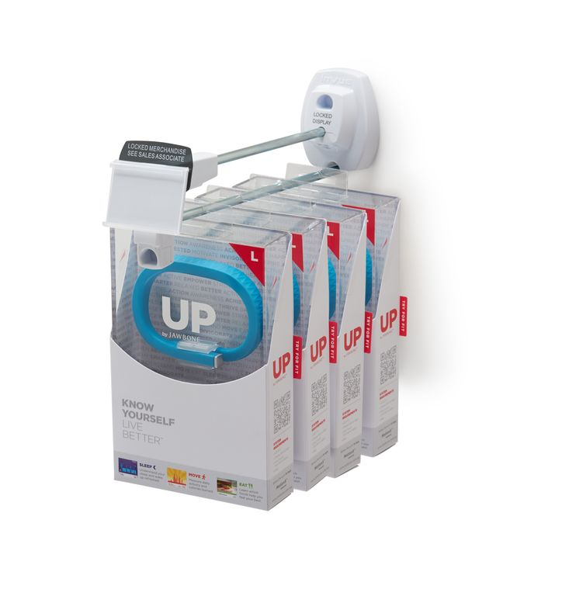
Go to Index
Locking Hooks
Locking Hooks
Front end and back end integrated locking mechanisms.
When finding an Order Code, you need to consider:
What key: OneKEY, OM, Q4?
What length: 6”, 7”, 9”, 11”, 12”?
What wall type: pegboard, slatwall, hangbar, wire grid?
IR (OneKEY) Locking Hooks
OM (SH500) Locking Hooks
Q4 (S3) Locking Hooks
*image from vitag.com.au

Slide 21
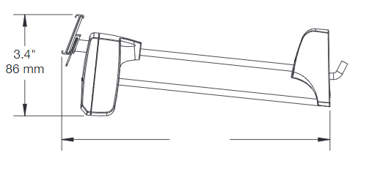
Go to Index
Locking Hooks
Info Tag
Front lock
Back lock
IR Locking Hooks
Uses the OneKEY (IR2 and beyond) to unlock the front end
Uses the OM Key to remove the back lock
Pegboard Inserts
(“Antlers”)
Wire
L
Greyed out Order Codes are Non-Stock
L (Hook Length) | Pegboard (American) | Pegboard (European) | Slatwall (Fastbak) May require spacers. See BACKWALL section. | Hangbar Refer to individual Order Code for hangbar dims.
6” / 15 cm | NL6 NL6-B¹ |  |  | NLBAR2
7” / 18cm | NL7 NL7-NT² NL7-CPT³ |  | NL7FB NL7FB-NT²
9” / 23cm | NL9 NL9-NT² NL9-CPT³ NL9-BB^{1,5} NL9SA⁶ | NL9E | NL9FB NL9FB-NT²
11” / 28cm | NL11
12” / 30.5cm | NL12
NOTES:
Black plastics
Does not include the front information tag
Custom price tag dimensions
Comes with pre-installed slatwall spacers
Black wire (custom to Samsung)
Has shorter pegboard inserts (“antlers”)

Slide 22
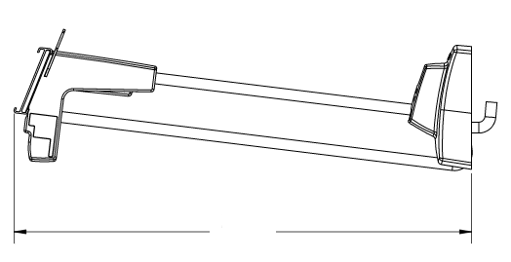
Go to Index
Locking Hooks
Front lock
Info Tag
Back lock
OM Locking Hooks (SH500)
Uses the OM Key to unlock the front end
Uses the OM Key to remove the back lock
Wire
Pegboard Inserts
(“Antlers”)
L
Greyed out Order Codes are Non-Stock
L (Hook Length) | Pegboard (American) | Pegboard (European) | Slatwall (Fastbak) May require spacers. See BACKWALL section. | Hangbar Refer to individual Order Code for hangbar dims. | Wire Grid Refer to individual Order Code for grid dims.
7” / 18cm | SFL05 SFL05-8⁷ SFL05K¹ |  | SFL05FB SFL05-0BB0⁴ | SFL05BAR1 | SFL05G3K
9” / 23cm | SFL01 SFL01K¹ SFL01H⁸ | SFL01E | SFL01FB |  | SFL01G2
12” / 30.5cm | SFL03
NOTES:
Black plastics
Does not include the front information tag
Custom price tag dimensions
Comes with pre-installed slatwall spacers
Black wire (custom to Samsung)
Has shorter pegboard inserts (“antlers”)
Alternative pack quantities
Includes wall reinforcement bracket
Customer specific restrictions in system

Slide 23
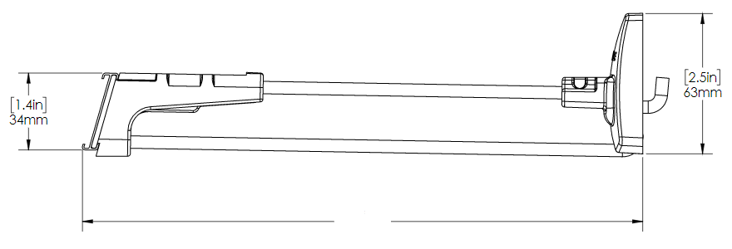
Go to Index
Locking Hooks
Back lock
Front lock
Info Tag
Q4 Locking Hooks
Uses the Q4 Key to unlock the front end
Uses the Q4 Key to remove the back lock
Wire
Pegboard Inserts
(“Antlers”)
L
Greyed out Order Codes are Non-Stock
L (Hook Length) | Pegboard (American) | Slatwall (Fastbak) May require spacers. See BACKWALL section.
6” / 15 cm | SHL6 SHL6-5⁷ CVS-SHL6-19⁷ CVS-SHL6-30⁷ | SHL6W
9” / 23cm | SHL9 SHL9-5CT⁷ SHL9-10⁷ SHL9-18⁷ SHL9-32⁷ TGT-SHL9-5⁷
11” / 28cm | SHL11
12” / 30.5cm | TGT-SHL12-25⁷
NOTES:
Black plastics
Does not include the front information tag
Custom price tag dimensions
Comes with pre-installed slatwall spacers
Black wire (custom to Samsung)
Has shorter pegboard inserts (“antlers”)
Alternative pack quantities
Includes wall reinforcement bracket
Customer specific restrictions in system

Slide 24
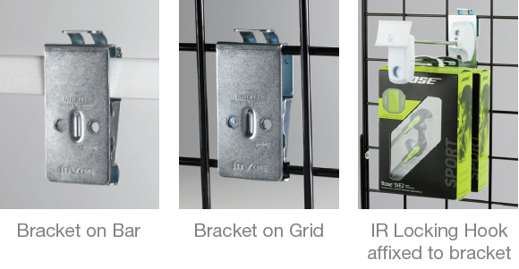
Go to Index
Locking Hooks
Open Face Tag
Closed Face Tag
Accessories
Tags
L
L
Greyed out Order Codes are Non-Stock
Tag Length
Face | 1.8” / 46mm | 2” | 2.25” / 57mm | 2.5” / 64mm | 2.6” / 66mm | 3.4” / 86mm | 3.5” / 89mm
Open | SHT¹ SHT-25¹ |  |  |  | SHTA003 | SHTA002
Closed |  | SHT-2.0³ | SHT-2.25-25 | SHT-2.50-25¹ |  |  | SHT-3.5^{1,2} SHT-3.5-S^{1,2}
Adapters
Greyed out Order Codes are Non-Stock
Pack Quantities | Bar | Wire Grid Refer to individual Order Code for grid dims. | Flat Bar
1 | SFBP01⁴ SFBP02⁴ | SFBP01 | SFBP03⁴
4 | SFBP01-4 | SFBP01-4
5 | SFBP01-5 | SFBP01-5
Bar/Grid Adapter
NOTES:
Ext. dimensions: 1.36” x 1.85” x 0.27”
Use on SF2LOK01
Information tag holder
Designed to fit specific bar dimensions

Slide 25
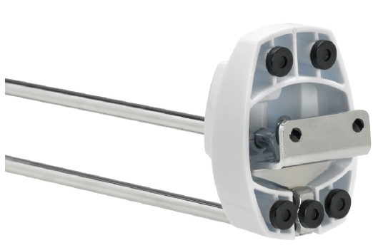
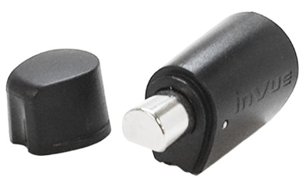
Go to Index
Locking Hooks
Plastic Hole Location
Accessories
Metal Hole Location
Slatwall (Fastbak) Spacers
Greyed out Order Codes are Non-Stock
Metal Hole Location
Hole Location | Thick Spacer | Thin Spacer
Metal | BPMB^{2,3} | BPMW^{1,3}
Plastic | BPPB^{2,3} | BPPW^{1,3}
Thin Spacer
Thick Spacer
Plastic Hole Location
Thin Spacer
Thick Spacer
Greyed out Order Codes are Non-Stock
Removal Tool | Order Code
OM Removal Tool | OM-RT³
OM Removal Tool
NOTES:
White
Black
For IR and OM Locking Hooks only

Slide 26
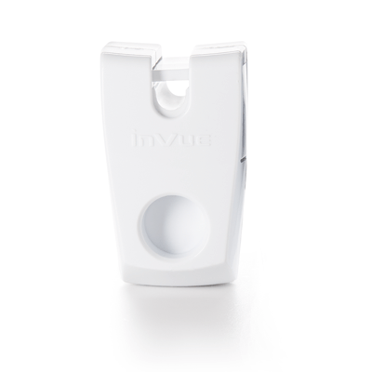
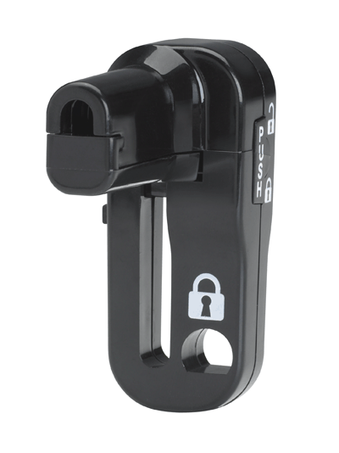
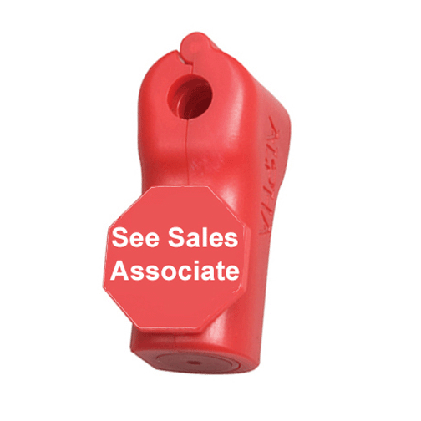
Go to Index
StopLoks
StopLoks
Locking security added to a hook.
When finding an Order Code, you need to consider:
What key: OneKEY, OM, Q4?
What hook wire diameter?: 4-8mm?
Circle
D-Shape
Tab(s)
IR (OneKEY) StopLoks
OM (SL500) StopLoks
Q4 (S3) StopLoks

Slide 27
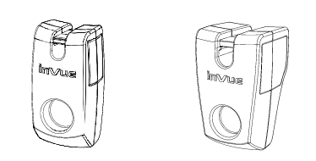
Go to Index
StopLoks
IR StopLok
Uses the OneKEY to unlock
Standard Style (Round Wire)
Thin Body
Thick Body
Greyed out Order Codes are Non-Stock
Wire Diameter
Frame / Body | 4.0 mm | 5.0 mm | 5.5 mm | 6.0 mm | 6.4 mm | 7.0 mm | 8.1 mm
Thin (6mm) | NS4 | NS6A | NS6B NS6B-B¹ | NS6C
Thick (8mm) |  |  |  |  | NS8A | NS8B NS8B-B¹ | NS8C
Other Styles
Greyed out Order Codes are Non-Stock
Style | Assembly | StopLok Only | Hook Only
Flat Hook | NS-FH01 | NS-FH-SINGLE | NSAP02
Loop Hook |  | NSLH-ESL
NOTES:
Black plastics

Slide 28
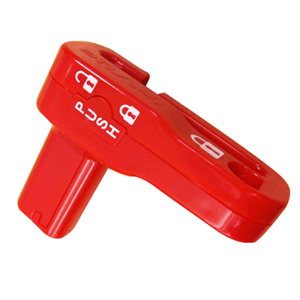
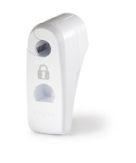
Go to Index
StopLoks
OM StopLok (SL500)
Uses the OM key to unlock
Standard Style (Round Wire)
Thin Body
Long Body
Thick Body
Greyed out Order Codes are Non-Stock
Wire Diameter
Frame / Body | 6.0 mm | 7.0 mm | 8 mm
Thin Body | SL4W
Long Body |  | SL5K¹ SL5R²
Thick Body |  |  | SL8W
NOTES:
Black plastics
Red plastics

Slide 29
Go to Index
StopLoks
Q4 StopLok
Uses the Q4 key to unlock
Single Tab Body uses only 1 of the 2 Q4 Key Tabs
Double Tab Body uses both Q4 tabs
1
2
1
Single Tab
Body
Double Tab
Body
Standard Style (Round Wire)
Greyed out Order Codes are Non-Stock
Wire Diameter
Q4 Key Tabs
Frame / Body | 5.5 mm | 6.0 mm
Single Tab | STOPLOK² | STOPLOK-SALES ASSOC² STOPLOK- SALES ASC-10²
Double Tab |  | S2LOK2NDL^{1,6} S2LOK2NDL-10^{1,4,6} S2LOK2RFL^{1,7} S2LOK2GR³ S2LOK2-ROSS⁵
NOTES:
Black plastics
Red plastics
Gray plastics
Alternative pack quantities
Customer specific
Includes AM EAS coil
Includes RF EAS coil

Slide 30
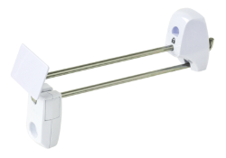
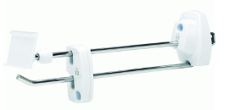
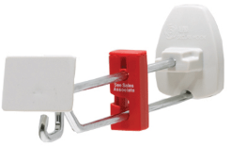
Go to Index
Flexible Locking Hooks
Flexible Locking Hooks
Front end stop lock with locking back.
When finding an Order Code, you need to consider:
What key: OneKEY or OM?
What style: Single Wire or Two Wire?
What length: 5”, 5.5”, 7”, 7.75”, 9”?
What wall type: pegboard, slatwall, hangbar?
IR (OneKEY) Flexible Locking Hooks
OM (SL500) Flexible Locking Hooks
Q4 (S3) Flexible Locking Hooks

Slide 31
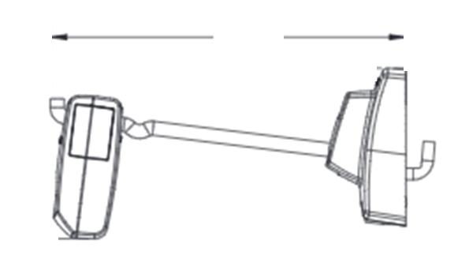
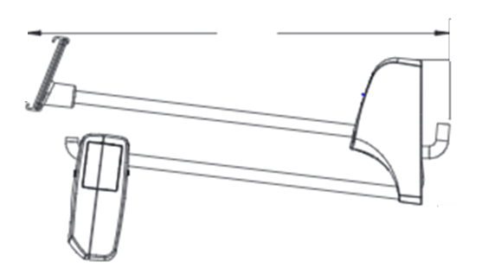
Go to Index
Flexible Locking Hooks
Single Wire
L
IR Flexible Locking Hooks
Uses the OneKEY (IR2 and beyond) to unlock the StopLok
Uses the OM Key to remove the back lock
Wire
Pegboard Inserts
(“Antlers”)
Single Wire
Greyed out Order Codes are Non-Stock
Front lock
L (Hook Length) | Pegboard (American) | Pegboard (European) | Slatwall (Fastbak) May require spacers. See BACKWALL section. | Hangbar Refer to individual Order Code for hangbar dims.
5.5” / 14cm | NFLOK5.5 SFLOK15S-NS6 | SFLOK15E-NS6 | SFLOK15S-NS6 | SFLOK15F-NS6
7.75” / 20cm |  |  |  | SFLOK16F-NS6
Double Wire
Info Tag
L
Wire
Pegboard Inserts
(“Antlers”)
Double Wire
Greyed out Order Codes are Non-Stock
L (Hook Length) | Pegboard (American) | Pegboard (European)
5” / 13cm | NF2LOK5
7” / 18cm | NF2LOK7 | NF2LOK7E
9” / 23cm | NF2LOK9 | NF2LOK9E
Front lock

Slide 32
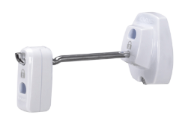
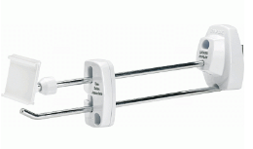
Go to Index
Flexible Locking Hooks
OM Flexible Locking Hooks (SH500)
Uses the OM Key to unlock the front end
Uses the OM Key to remove the back lock
Single Wire
Single Wire
Greyed out Order Codes are Non-Stock
L (Hook Length) | Pegboard (European) | Slatwall (Fastbak) May require spacers. See BACKWALL section. | Hangbar Refer to individual Order Code for hangbar dims.
5.5” / 14cm | SFLOK15E | SFLOK15S | SFLOK15F
7.75” / 20cm |  |  | SFLOK16F
Double Wire
Double Wire
Greyed out Order Codes are Non-Stock
L (Hook Length) | Pegboard (American) | Pegboard (European) | Slatwall (Fastback) May require spacers. See BACKWALL section.
7” / 18cm |  | SF2LOK05E
9” / 23cm | SF2LOK01 |  | SF2LOK01FB

Slide 33
Go to Index
Flexible Locking Hooks
Open Face Tag
Closed Face Tag
Accessories
Tags
L
L
Greyed out Order Codes are Non-Stock
Tag Length
Face | 1.8” / 46mm | 2” | 2.25” / 57mm | 2.5” / 64mm | 2.6” / 66mm | 3.4” / 86mm | 3.5” / 89mm
Open | SHT¹ SHT-25¹ |  |  |  | SHTA003 | SHTA002
Closed |  | SHT-2.0³ | SHT-2.25-25 | SHT-2.50-25¹ |  |  | SHT-3.5^{1,2} SHT-3.5-S^{1,2}
Adapters
Greyed out Order Codes are Non-Stock
Pack Quantities | Bar | Wire Grid Refer to individual Order Code for grid dims. | Flat Bar
1 | SFBP01⁴ SFBP02⁴ | SFBP01 | SFBP03⁴
4 | SFBP01-4 | SFBP01-4
5 | SFBP01-5 | SFBP01-5
Bar/Grid Adapter
NOTES:
Ext. dimensions: 1.36” x 1.85” x 0.27”
Use on SF2LOK01
Information tag holder
Designed to fit specific bar dimensions

Slide 34
Go to Index
Flexible Locking Hooks
Plastic Hole Location
Accessories
Metal Hole Location
Slatwall (Fastbak) Spacers
Greyed out Order Codes are Non-Stock
Metal Hole Location
Hole Location | Thick Spacer | Thin Spacer
Metal | BPMB^{2,3} | BPMW^{1,3}
Plastic | BPPB^{2,3} | BPPW^{1,3}
Thin Spacer
Thick Spacer
Plastic Hole Location
Thin Spacer
Thick Spacer
Greyed out Order Codes are Non-Stock
Removal Tool | Order Code
OM Removal Tool | OM-RT³
OM Removal Tool
NOTES:
White
Black
For IR and OM Flexible Locking Hooks only

Slide 35
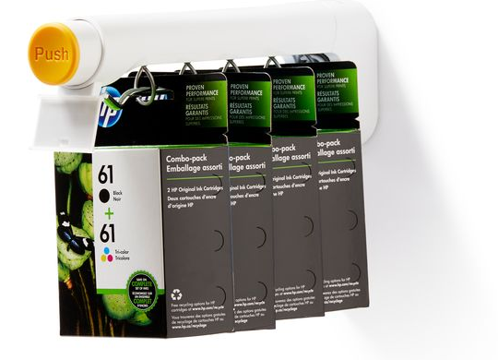
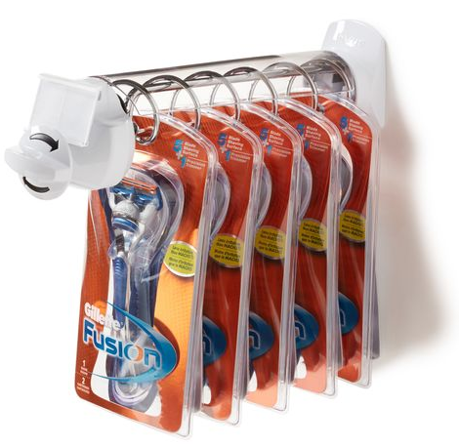
Go to Index
Dispensers
Dispensers
Front end push button or turn knob with locking back.
When finding an Order Code, you need to consider:
Coil spacing: 12mm, 30mm, 50mm?
What length: 9”, 12”?
What wall type: pegboard, slatwall, hangbar?
T1000 Dispenser
Helix Dispenser

Slide 36
Go to Index
Dispensers
Dispenser
L
T1000 Dispenser
Uses T22 bit in AF6313 multi-tool for mounting
Match coil spacing to merchandise thickness
Dispenser
Coil Spacing
Greyed out Order Codes are Non-Stock
Price Tag
Coil Spacing | Dispenser | Replacement Coil
15mm | T1040 | T1047¹
30mm | T1041⁴ | T1048^{1,4}
50mm | T1042 | T1049¹
Rod
Rod
Greyed out Order Codes are Non-Stock
Rod Length | Pegboard (American) | Pegboard (European) | Slatwall (Fastbak) May require spacers. See BACKWALL section. | Hangbar Refer to individual Order Code for hangbar dims. | Uni-web
12” / 30.5cm | T1046-A | T1046-E | T1046-S T1046-UW | T1046-A1 T1046-B1² T1046-B2² T1046-B3² T1046-B4^{2,5} T1046-INS³ | T1046-UW
NOTES:
Alternative pack quantities
Custom hangbar dimensions
Includes insert
Includes anti-jam feature
Left/right adjustment features

Slide 37
Go to Index
Dispensers
T1000 Dispenser
Uses T22 bit in AF6313 multi-tool for mounting
Match coil spacing to merchandise thickness
Greyed out Order Codes are Non-Stock
Multi Tool
Add-on Component | Order Code
Multi Tool (for Removal) | AF6313
T1000 Coil Support – Upgrade Kit | T1000-MTANG
Spacers | T1046-AMETAL¹ T1046-EMETAL²
Shim | T1000-SHIM1³
NOTES:
For pegboard (American version)
For pegboard (European version)
For T1046 hangbar

Slide 38
Go to Index
Dispensers
L
Helix Dispenser
Uses the OM Key for installation and removal
Short Length (9” / 23cm)
Coil Spacing
Greyed out Order Codes are Non-Stock
Coil Spacing | Pegboard (American)
20mm | SFH03-20S
Standard Length (12” / 30.5cm)
Greyed out Order Codes are Non-Stock
Coil Spacing | Pegboard (American) | Hangbar Refer to individual Order Code for hangbar dims. | Uni-web
15mm | SFH03-15C³
20mm | SFH03-20^{1,2} SFH03-20-6⁴ SFH03-20C³ SFH03-20L^{3,5} | SFH03-20T | SFH03-20UW
35mm | SFH03-35^{1,2} | SFH03-35T
NOTES:
Time delay
Includes protective shroud
No switch
Alternative pack quantities
Includes metal wallboard shim

Slide 39
Go to Index
Dispensers
OM Removal Tool
Helix Dispenser
Uses the OM Key for installation and removal
Greyed out Order Codes are Non-Stock
Add-on Component | Order Code
OM Removal Tool | OM-RT
Helix Stopper | SFH03-STOP
Shim | SFSHM01¹
Shim
Slatwall Adapter
NOTES:
For wallboard

Slide 40
Go to Index
Anti-Sweep Hooks
Anti-Sweep Hooks
Front end and back end integrated locking mechanisms.
When finding an Order Code, you need to consider:
What style: Single Wire or Two Wire?
OM (SH500) Anti-Sweep Hook
*image from gateway-security.cl
Q4 Anti-Sweep Hook

Slide 41
Go to Index
Anti-Sweep Hooks
Q4 Anti-Sweep Hooks
Uses the Q4 Key to remove the back lock
Single Wire
Single Wire
Greyed out Order Codes are Non-Stock
L (Hook Length) | Pegboard (American)
9” / 23cm | SHS9SR
Double Wire
Double Wire
Greyed out Order Codes are Non-Stock
L (Hook Length) | Pegboard (American)
9” / 23cm | SHS9

